Slide 1
PATIENT MANAGEMENT SYSTEM 2023-24 BY: YASHWANT SINGH VISHAL KUMAR VIPIN SHARMA UJJAWAL TYAGI SUPERVISED BY: Dr. SANGEETA ARORA

Slide 2
ABSTRACT
The Patient Management System is a Python-based software solution designed to streamline the operations of healthcare facilities. This system offers a comprehensive set of features for efficient patient data management, appointment scheduling, medical records maintenance, billing, and more. With a user-friendly interface and a focus on data security and compliance, it empowers healthcare professionals to deliver superior patient care. Key components include patient registration, appointment scheduling, electronic medical records, billing and invoicing, reporting, user access control, integration capabilities, data backup, and adherence to healthcare data privacy regulations. This system aims to enhance efficiency of Patient , reduce administrative overhead, and improve the overall quality of healthcare services related to Patients.

Slide 3
INTRODUCTION
Hospitals are the essential part of our lives which provides us with the best medical facilities for various sickness, it may be due to the change in climatic conditions, stress (emotional trauma) etc. It is necessary for the hospital to keep track of all activities and records day in and day out of its patient, doctors, nurses and other staffs that keeps the hospital in its operation
Keeping track of all activities and reports on paper is very inefficient and time consuming and also error prone. Keeping records on paper is a traditional base system that sometimes do not make it robust, in any case of damage all files will be lost that will cost a lot to the organization Day in and day out many people visit the hospital and when using the traditional base system it make it unreliable in the sense that it will take longer time to enter or access data and also maintaining. It is not economically and technically feasible to maintain these records on paper.
Patient Management System (PMS) is a comprehensive web-based application designed to streamline healthcare facilities and enhance patient management. This project aims to provide a centralized platform that allows doctors, patients, and clinic administrators to efficiently manage medical records, appointments, and communication.
The primary objective of the Patient Management System is to improve the patient experience, optimize healthcare provider efficiency, and maintain accurate and secure medical records. By leveraging technology, the system simplifies the management of healthcare facilities and enhances the overall quality of care provided.

Slide 4
PROBLEM STATEMENT
A patient must wait in the hospital for a physician's appointment. The patient also queues for an appointment. The patient will not learn whether the doctor cancelled the appointment due to an emergency until they arrive at the hospital. This is tedious for all involved.
Most people do not know what to eat when they have a fever or other illness, so eating the wrong foods will make them sicker.
Our Python-Based Patient Management System manages appointments of Doctors.. It is simple to schedule a doctor's appointment online using the system. It also provides an efficient solution in which users can view various booking slots and select their preferred date and time, as well as an AI-powered chatbot that advises patients to avoid foods that will make them sicker, recommends common medications, etc.
This project's front end consists of HTML, CSS, and JavaScript, while the back end is written in Python and Machine Learning. MySQL Database as the database, Flask as the framework, and AI chatboat which uses ML.

Slide 5
OBJECTIVES
The system offers a dedicated dashboard for doctors to manage their appointments, view patient records, and update their profiles. Doctors can efficiently organize their schedules and access patient information in a user-friendly interface.
Patients have access to a personalized dashboard that enables them to schedule appointments, access their medical history, and communicate with their doctors. They can easily book appointments, track their healthcare journey, and receive important notifications.
Clinic administrators can efficiently manage doctors, appointments, and clinic information through a comprehensive admin dashboard.
AI Chatbot will be introduced which will empower patients with personalised recommendation through AI – powered chatbot, offering guidance on yoga , dietary choices and medications.

Slide 6
PROJECT OUTCOME
Improved Patient Care
Accurate Data Management
Streamlined Workflow
Data Analysis
Integration Capabilities
Scalability
Cost Savings

Slide 7
ADVANTAGES:
The system is straightforward to maintain.
It is easy to use.
It makes scheduling doctor's appointments simple and efficient.
Patients can schedule appointments without leaving their homes.
It can aid in reducing patient absences.

Slide 8
SYSTEM DESCRIPTION
Admin:
1. Login:
The admin can log in using their credentials.
2. Manage Doctor:
The admin can add, update, delete and view doctors’ details.
3. View Patients:
The admin can search patients by their name and patient Id.
They can view the patients’ details and the past treatments.

Slide 9
SYSTEM DESCRIPTION
4. View Appointments:
The admin can view the appointment details by filtering the dates.
5. View Feedback:
They can also view the feedback given by patients.

Slide 10
Doctor: 1 Login: The doctor can log in using their credentials. 2 Profile: The doctor can manage their profile. 3 Change Password: They can change their passwords if they want. 4 View Appointments: The doctor can view the appointment details by filtering the dates. They can also view patient details and their past treatments. They can add treatment for their patients. 5 View Patients: The doctor can search for patients by their names or patient Ids. They can view patient details and their past treatments.

Slide 11
PATIENT:
1 Register:
The patient would need to register first to log in.
2 Login:
The patient can log in after registering.
3 Profile:
They can manage their profile.
4 Change Password:
They can change their password if they want.
5 New Booking: g all the selections, they can book an appointment.
6 Booking History:
The patient can view all their appointments here.
They can cancel bookings anytime they want.

Slide 12
7 Search Doctor:
The patient can search doctors by their name, type and locality.
They can view the doctors’ details.
8 Feedback:
They can give feedback to Admin.
9 Treatments:
The patient can view treatments and the details added by doctors.

Slide 13
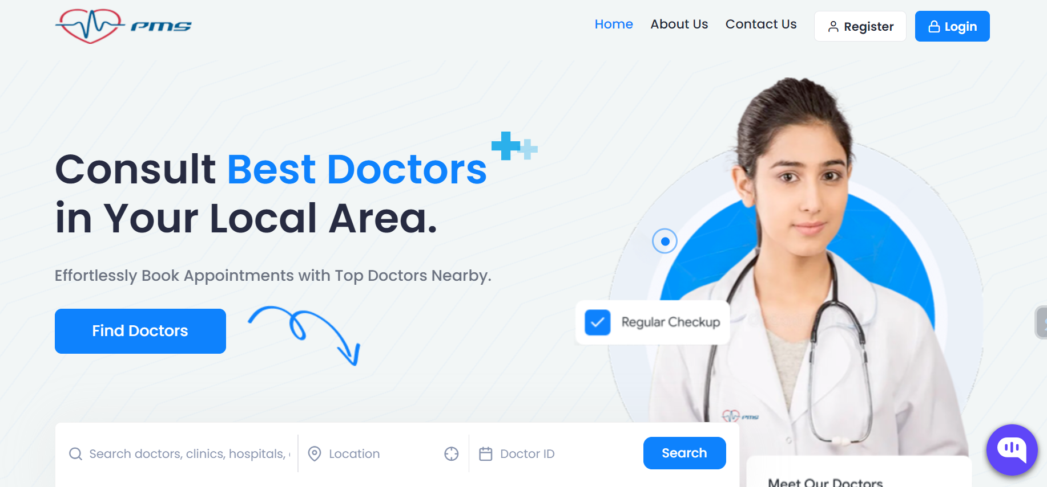
PROJECT WORK
1. Home Page

Slide 14
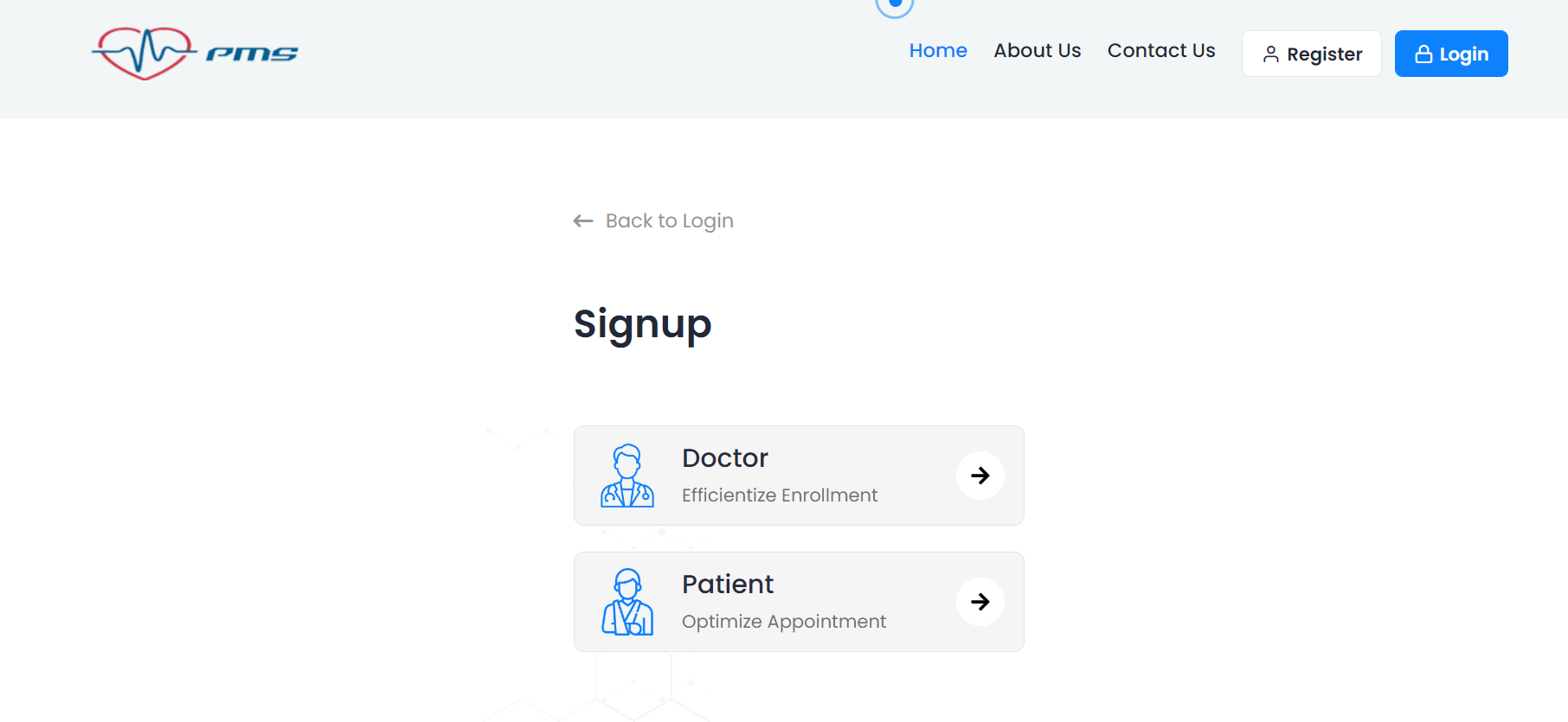
2. Login Page

Slide 15
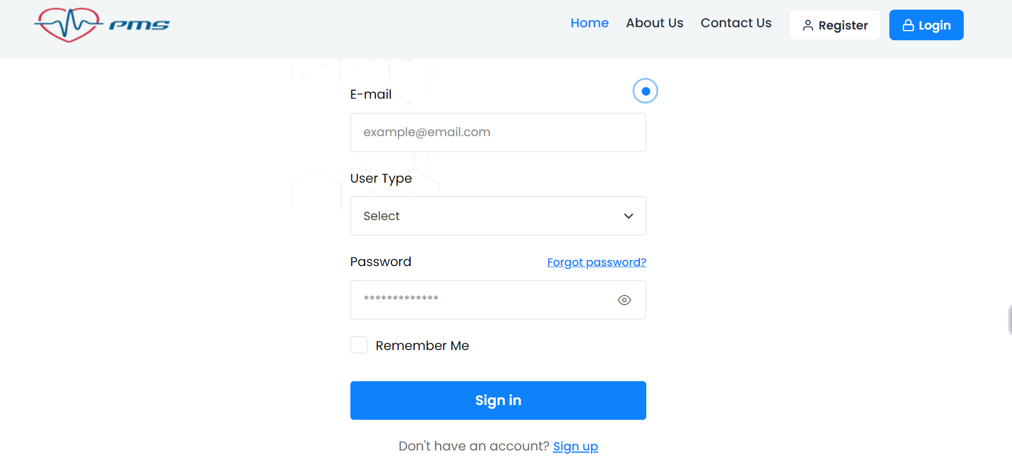
3. Doctor/Patient Register Page

Slide 16
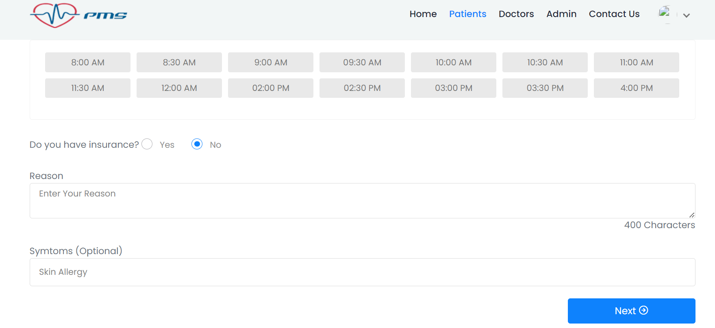
4. Patients Appointment Booking Page

Slide 17
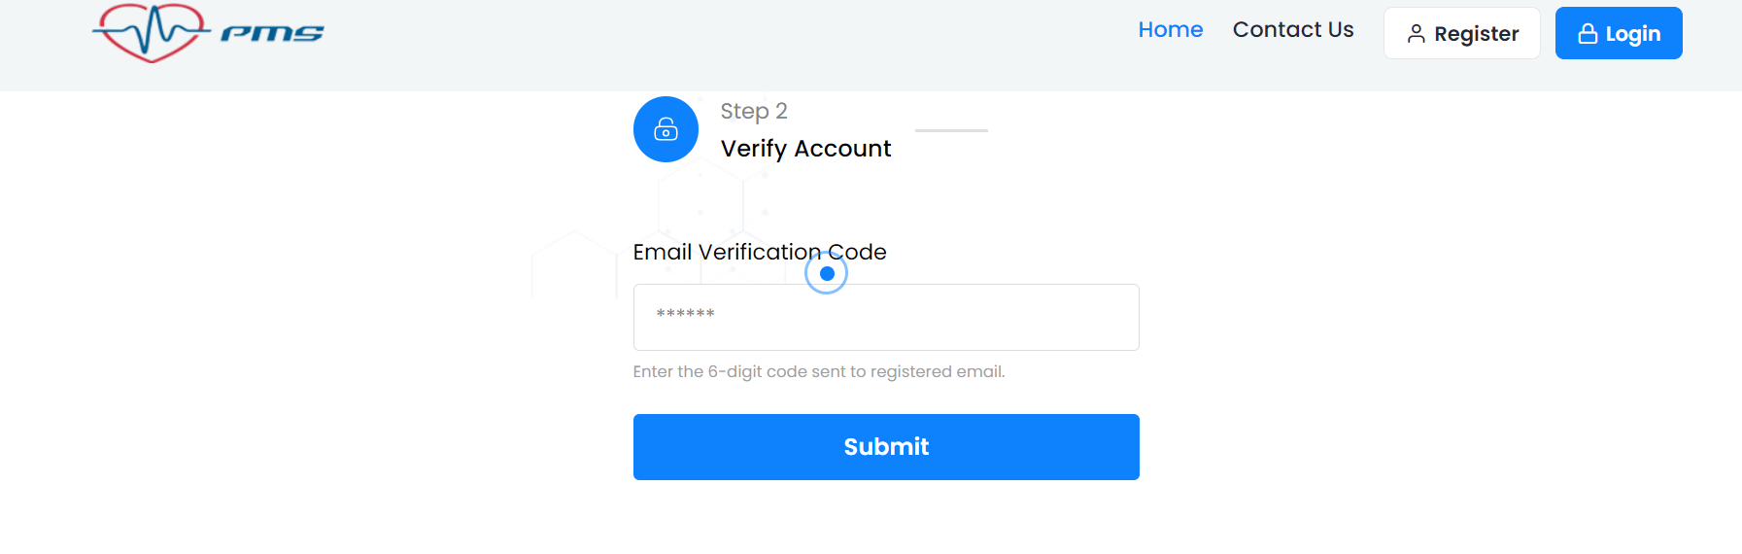
5. Verification Account Page

Slide 18
SYSTEM REQUIREMENTS
1. Hardware Requirement:
Laptop or PC
Windows 7 or higher
i3 processor system or Higher
4 GB RAM or Higher
100 GB ROM or Higher
2. Software Requirement:
Laptop or PC
Python 3
Visual Studio Code Editor
MySQL Database
Flask Framework

Slide 19
APPLICATIONS
The system allows patients or any user to schedule a doctor's appointment online with ease.
REFERENCES
https://www.jetir.org/papers/JETIR2005455.pdf
https://www.academia.edu/26066176/Design_and_Development_of_Online_Doctor_Appointment_System
https://ijcrt.org/papers/IJCRT1812133.pdf
https://arxiv.org/ftp/arxiv/papers/1701/1701.08786.pdf

Slide 20
Thank you

